Slide 1
A Configurable SRAM for Low-Voltage Operation in 32nm High-κ Metal-Gate CMOS
Manny Xu CKT
20180502

Slide 2
Agenda
Configurable SRAM
Bl 恒定负电平
Wl programmable

Slide 3
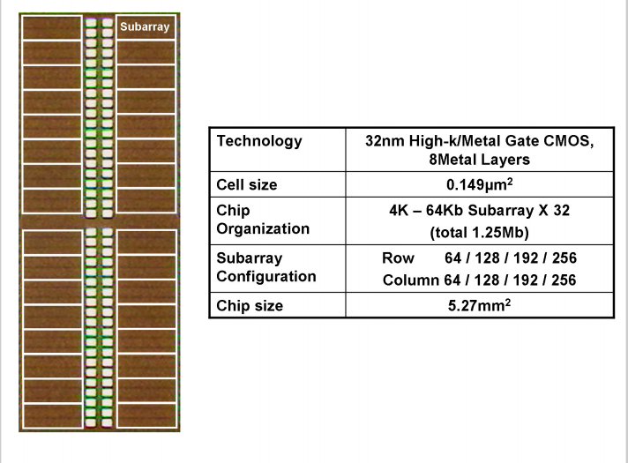
背景
a configurable SRAM for low-voltage operation
Notes:
Functionality and high yield at low supply voltages such as 0.7V has become more difficult to achieve with the degradation of write margin and the optimization between read disturb and write margin

Slide 4
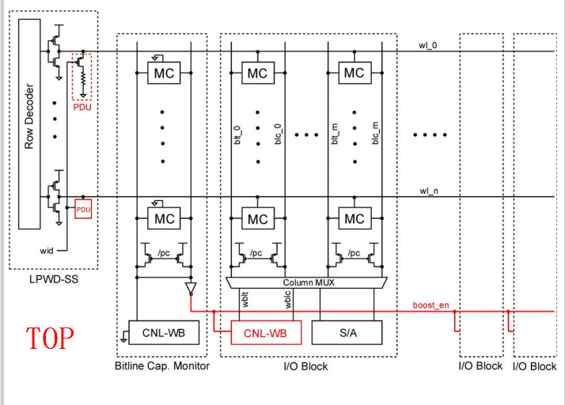
背景
BL negative biasing and WL level control
Notes:
BL capacitance monitor working as a replica of a BL generates a signal activating the bootstrap (boost_en). Every WL driver has a pull-down unit (PDU) to lower the WL voltage for optimizing the tradeoff between disturb and write margin.

Slide 5
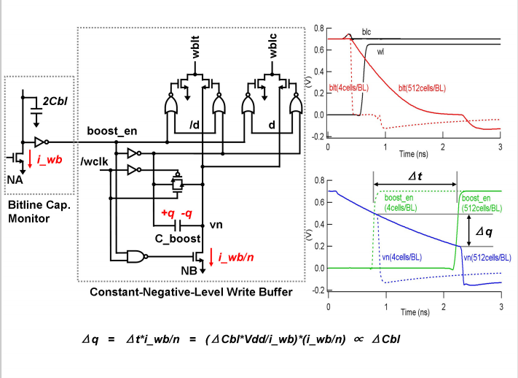
constant-negative-level
Notes:
针对写buffer

Slide 6
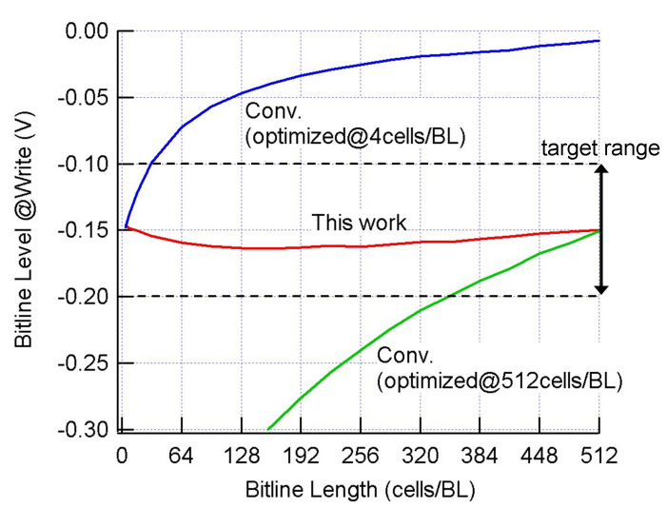
constant-negative-level

Slide 7
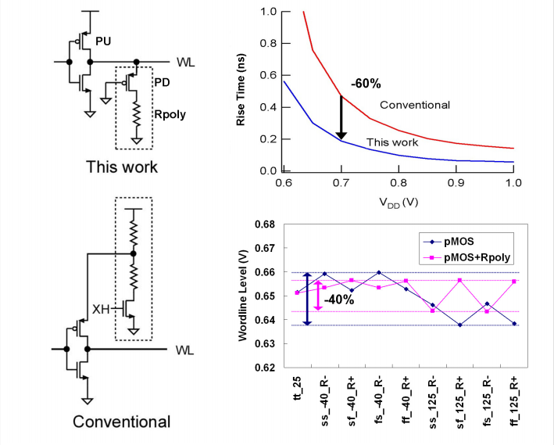
level programmable wl driver

Slide 8
Thank you

